Slide 1

Sentiment Analysis on Amazon reviews
IST 664 - Patrick, Dale, Monica

Slide 2

Agenda
About the Data
Preprocessing
Comparing Lexicons
Naïve Bayes
Insights

Slide 3

About the Data
Kaggle dataset which contains 4,914 Amazon product reviews for a specific SanDisk hard drive
Key Variables (12 total):
ReviewerName (str) - Username that wrote review
Overall Rating (float) - the total stars reviewer left to rate product
ReviewText (str) - Text comment that user wrote
ReviewTime (date) - Time at which the review was posted

Slide 4
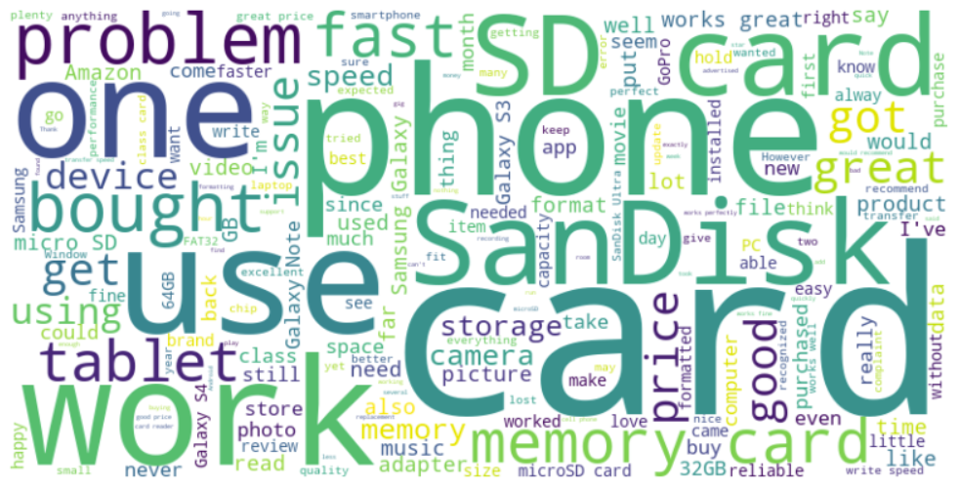
About the Data

Slide 5
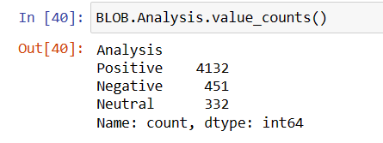
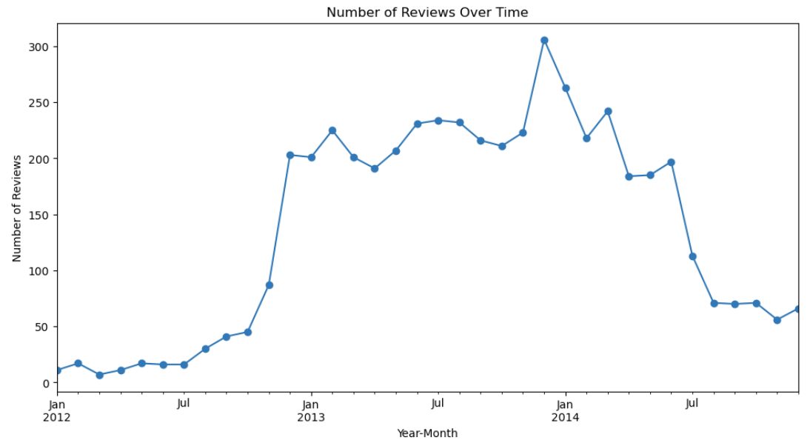
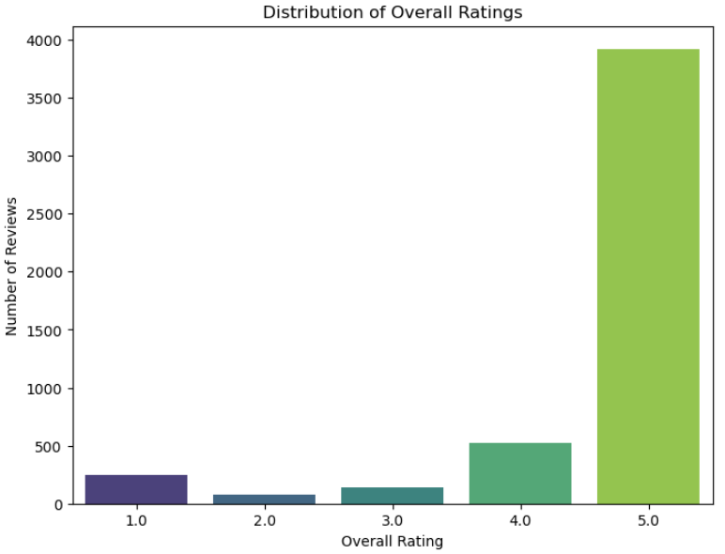
About the Data

Slide 6

Pre-Processing
Cleaning
Removed special characters and numbers
Tokenization
Sentences were already separated.
Word tokenization was done, giving us a list of lists of strings
POS tagging
Stopword removal
Lemmatization

Slide 7
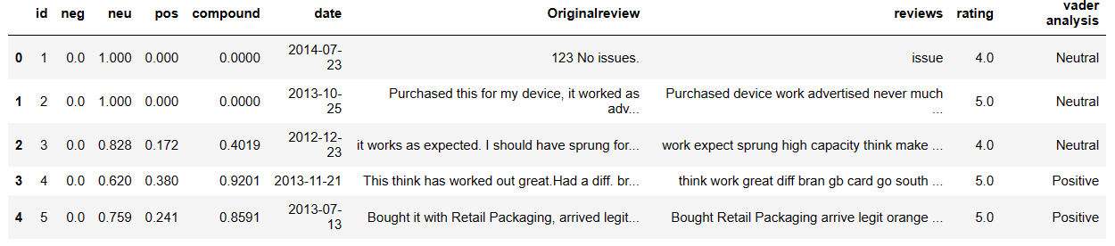
Sentiment Analysis - Vader
VADER (Valence Aware Dictionary and Sentiment Reasoner) is a lexicon which specializes in determining sentiments expressed in social media
Its lexicon returns positive, negative, and neutral scores, with a reflecting compound score
Compound scores to comment sentiment:
Greater than .5 = Positive Review
Between 0 and .5 = Neutral Review
Less than 0 = Negative Review

Slide 8
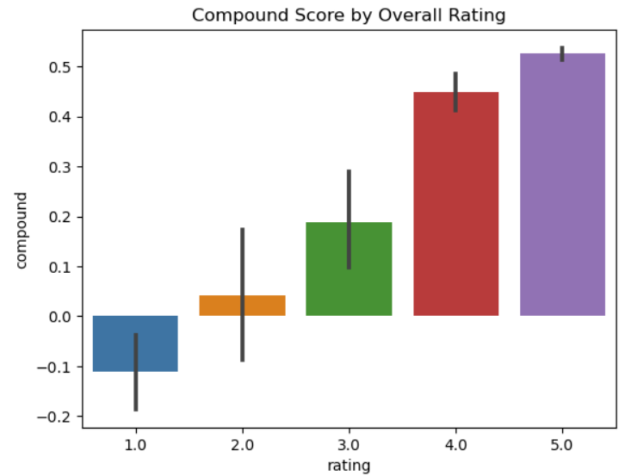
Sentiment Analysis - Vader
Visualizing compound scores against user rating
Most reviews are being classified as either positive or neutral.
Strong distinction between positive and negative reviews
Can see the 1 star reviews have a negative compound score

Slide 9
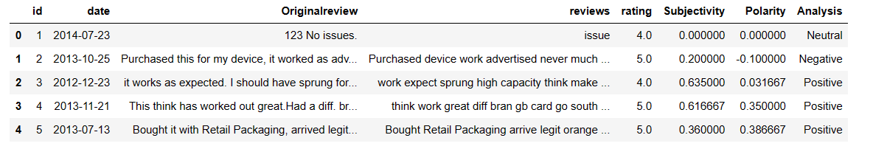
Sentiment Analysis - TextBlob
TextBlob analyzes the sentiment in texts, focusing closely on the words and their POS tags
Returns subjectivity and polarity scores.
Polarity scores map to comment sentiment:
Greater than 0= Positive Review
Equals to 0 = Neutral Review
Less than 0 = Negative Review

Slide 10
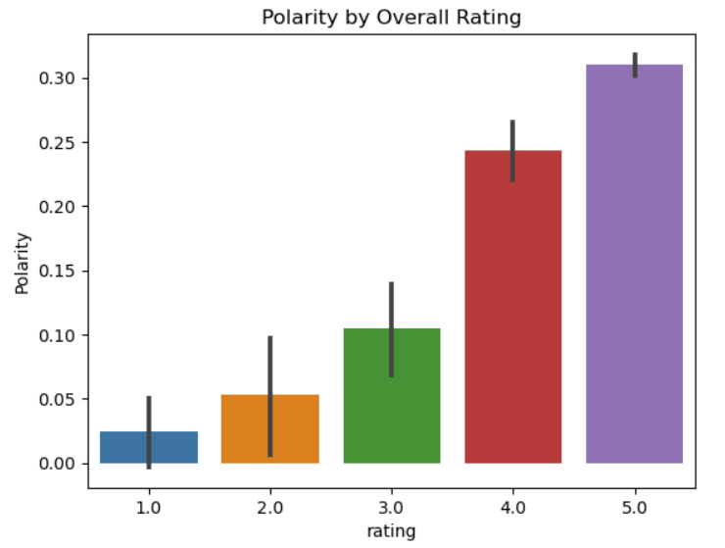
Sentiment Analysis - TextBlob
Most of the reviews classified as positive similar to Vader
Unlike Vader, less confidence in magnitude of how negative a 1 star review is
Negative reviews were categorized as only barely negative

Slide 11
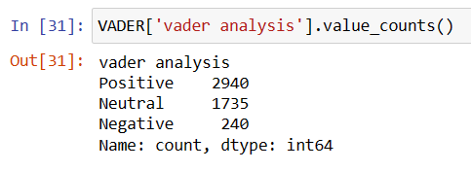
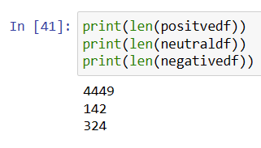
Comparing Lexicon results - Vader vs. TextBlob
Big difference in value count between Vader and Textblob
Seemed like Vader struggled to define many reviews and categorized them as neutral
TextBlob more accurate to the star rating that the user left
Data set with more negative reviews for training might help Vader classify neutral reviews
Subjectivity of star reviews- is a 3 star review really neutral or not?

Slide 12
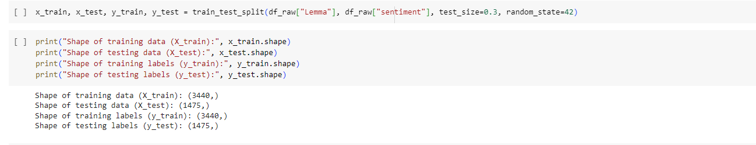
Naive Bayes – Training and Test data creation
Used a 70/30 split of our data to create a training and test data set
Training dataset contains 3440 reviews
Test dataset contains 1475 reviews

Slide 13
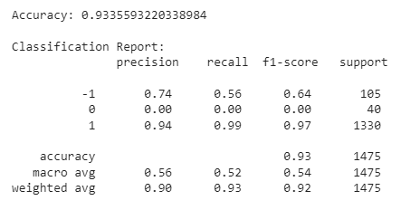
Naive Bayes – Processed reviews
93.35% accuracy
Low support for negative reviews and neutral reviews
Model has a high precision classifying positive reviews but is not as precise with negative reviews
Model has trouble classifying neutral reviews

Slide 14
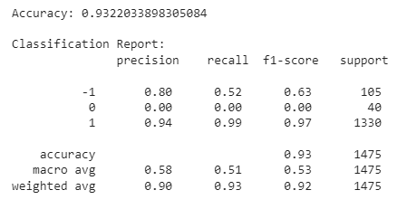
Naive Bayes – Unprocessed Reviews
93.22% accuracy – slightly lower that previous model
Also has low support for negative and neutral reviews
Precision for positive reviews remained the same, however, precision for negative reviews went up
This model also had trouble classifying neutral reviews

Slide 15
TF-IDF
Utilized NLP techniques with spaCy and NLTK.
TF-IDF (Term Frequency-Inverse Document Frequency) used for feature extraction.
Measures the importance of terms in documents relative to the entire corpus.
Utilized scikit-learn's TfidfVectorizer for TF-IDF vectorization.
Split the dataset into training and testing sets (80-20 split).
Transformed the raw text data into numerical vectors.

Slide 16
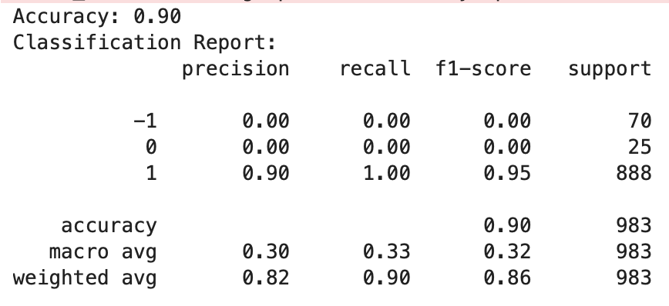
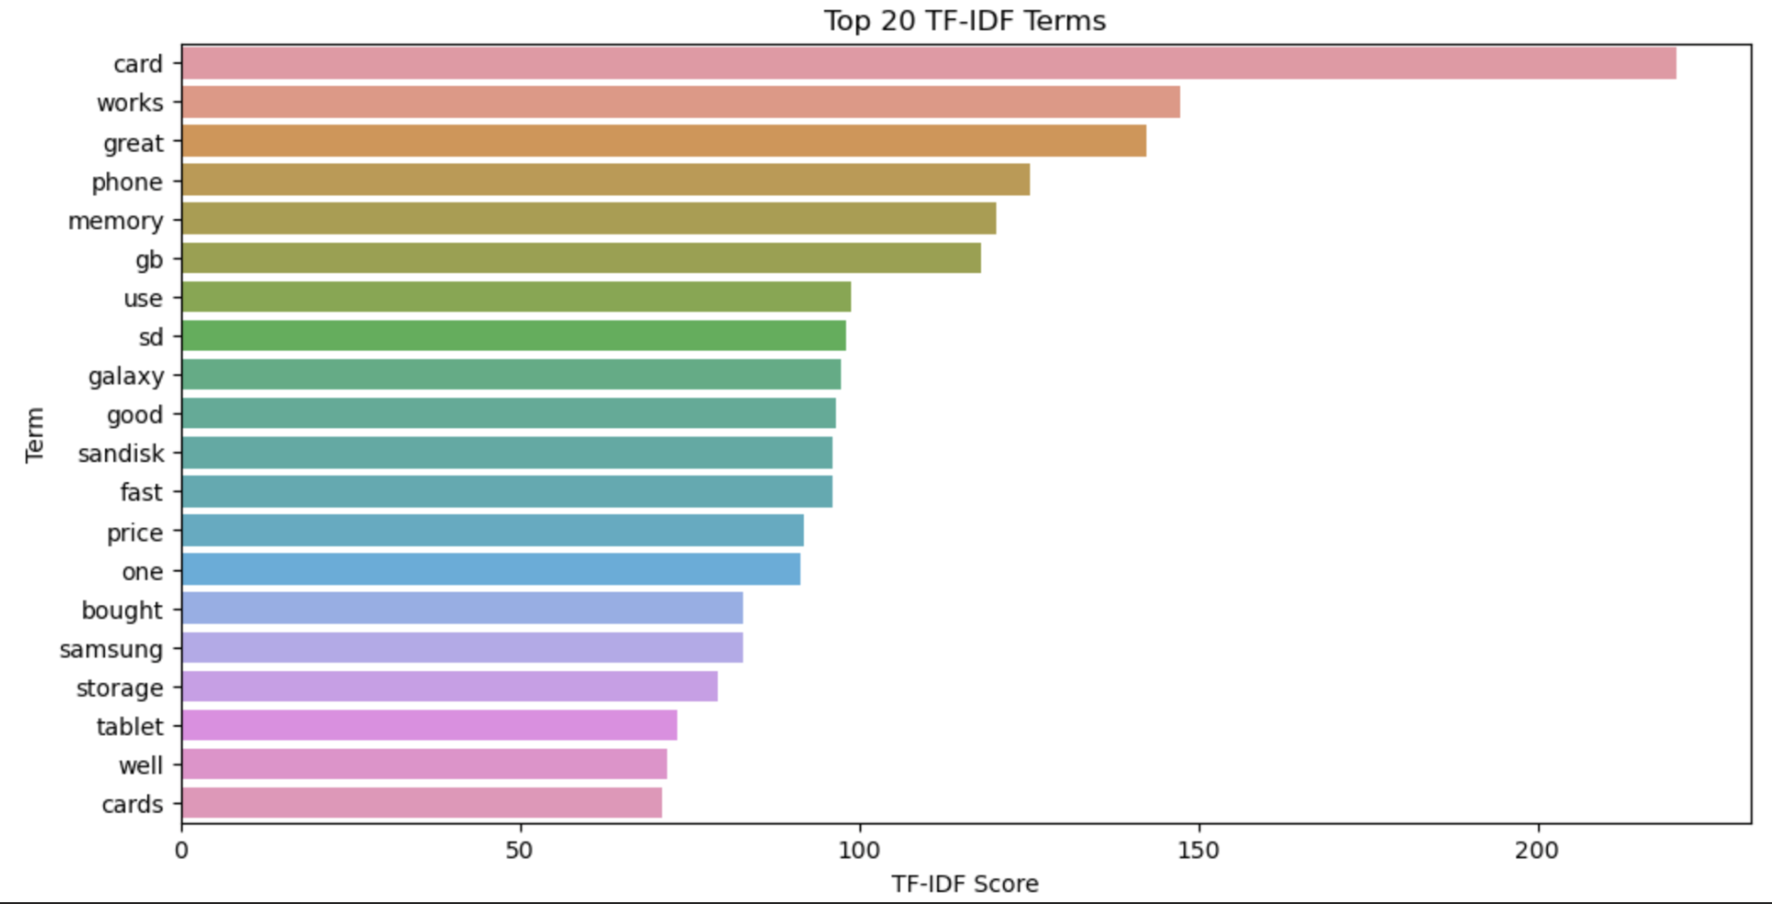
Naive Bayes Classification
Tested the classifier on the TF-IDF vectorized testing data.
Calculated accuracy, precision, recall, and F1-score for model evaluation.
Results:
Achieved an accuracy of 90%, indicating the model's overall correctness.
The model demonstrates high precision, recall, and F1-score for positive sentiment (1).
Limited success in predicting negative sentiment (-1), likely due to imbalanced data.

Slide 17

Insights and Takeaways
Might want to use a larger dataset in the future and dataset with more even representation of negative and positive reviews
Not enough neutral or negative reviews to properly train the model to make that classification
Not accounting for subjectivity in rating scale (is a 3 star rating neutral, positive or negative)
Slightly higher model accuracy with processed data

